Slide 1
FoodPro - Online food delivery database system & analytics
By
Prajwal Srinivas

Slide 2
INTRODUCTION
FoodPro is an application where users can order food from various restaurants. For users to be able to use the application and place orders, they must create an account on the application with their email and an address; post which each accounts given a unique account_id. After that the users are given two options regarding their account type,
1. Free Account
2. Gold Account
For a Gold Account, a user must pay a subscription fee, post which they get access to discounts for a period of 100 days. The different subscription options are gold, gold_plus and gold_pro. The users get to choose various restaurants, where every restaurant has a unique restaurant_id; after choosing the restaurant the user selects the items to order from the restaurant menu. Every menu has a unique menu_id and different course_names. The order placed by the user account is assigned to delivery agent who would deliver the order. The delivery agent has a unique agent_id and is given order details and user address to fulfil the order. The focus of this project is to effectively maintain the order management system and subsequently decide on an optimization of assignment of delivery agents across the cities. It would also aid the restaurant decide on the inventory for the popular dishes and understand the preferences of the user better. The analysis would help in producing optimal locations for opening new restaurant's branches. It would also help understand the customer demography better, and appropriately produce effective campaigns for selling the gold subscription plans and effectively increase sales/orders.

Slide 3
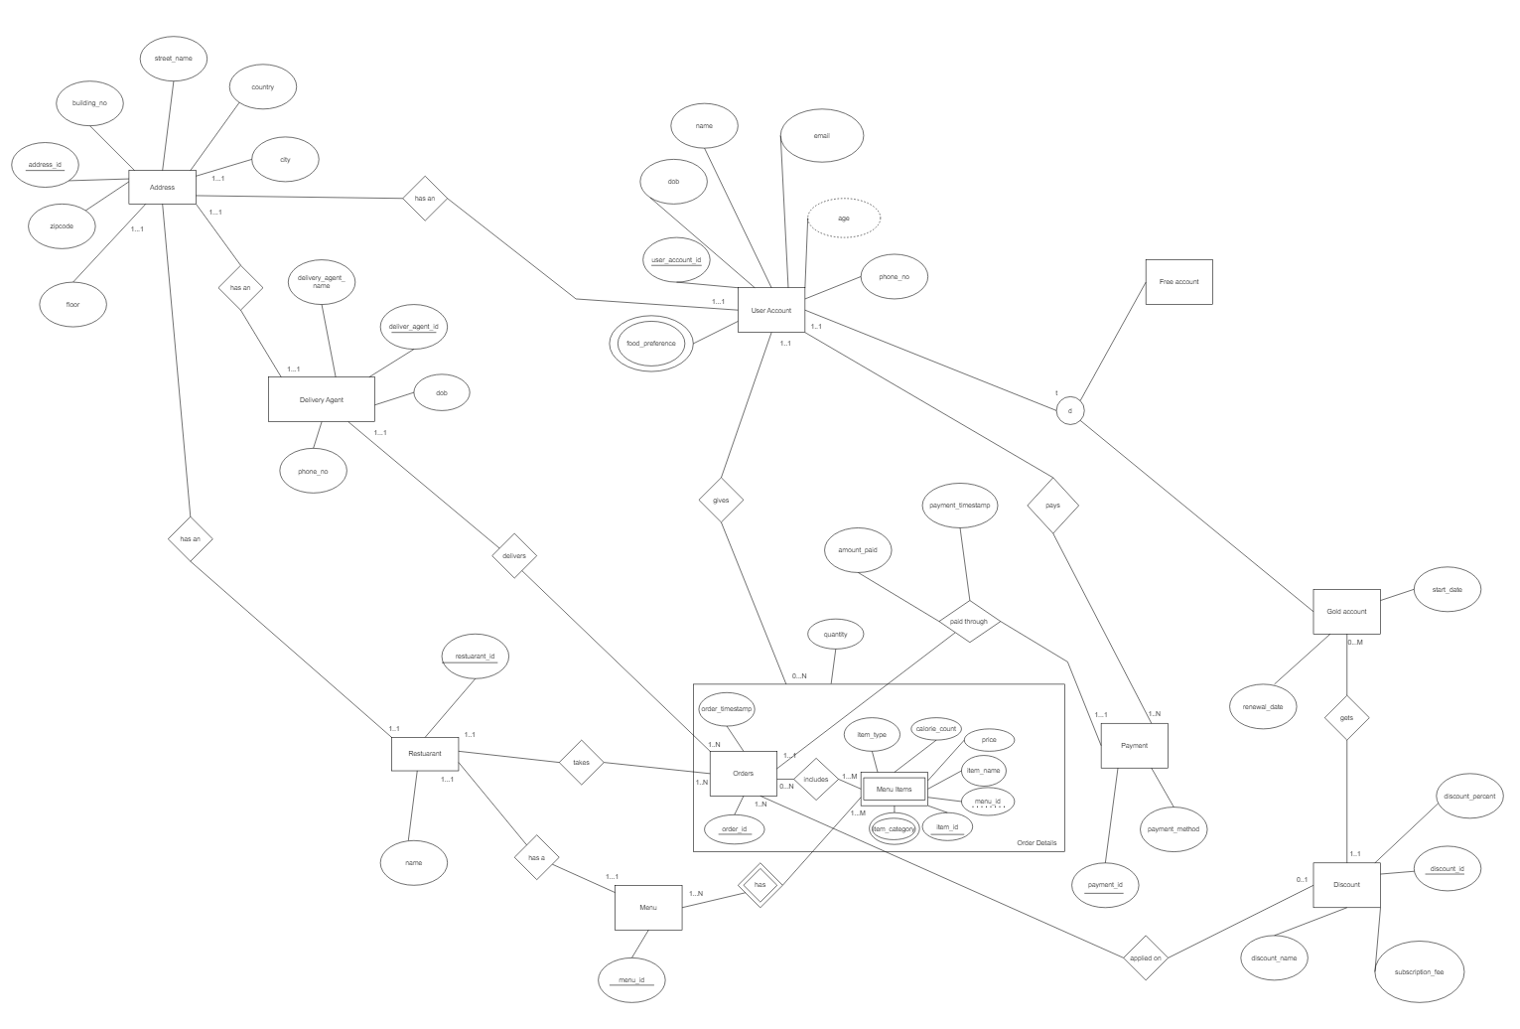
ER-Diagram

Slide 4
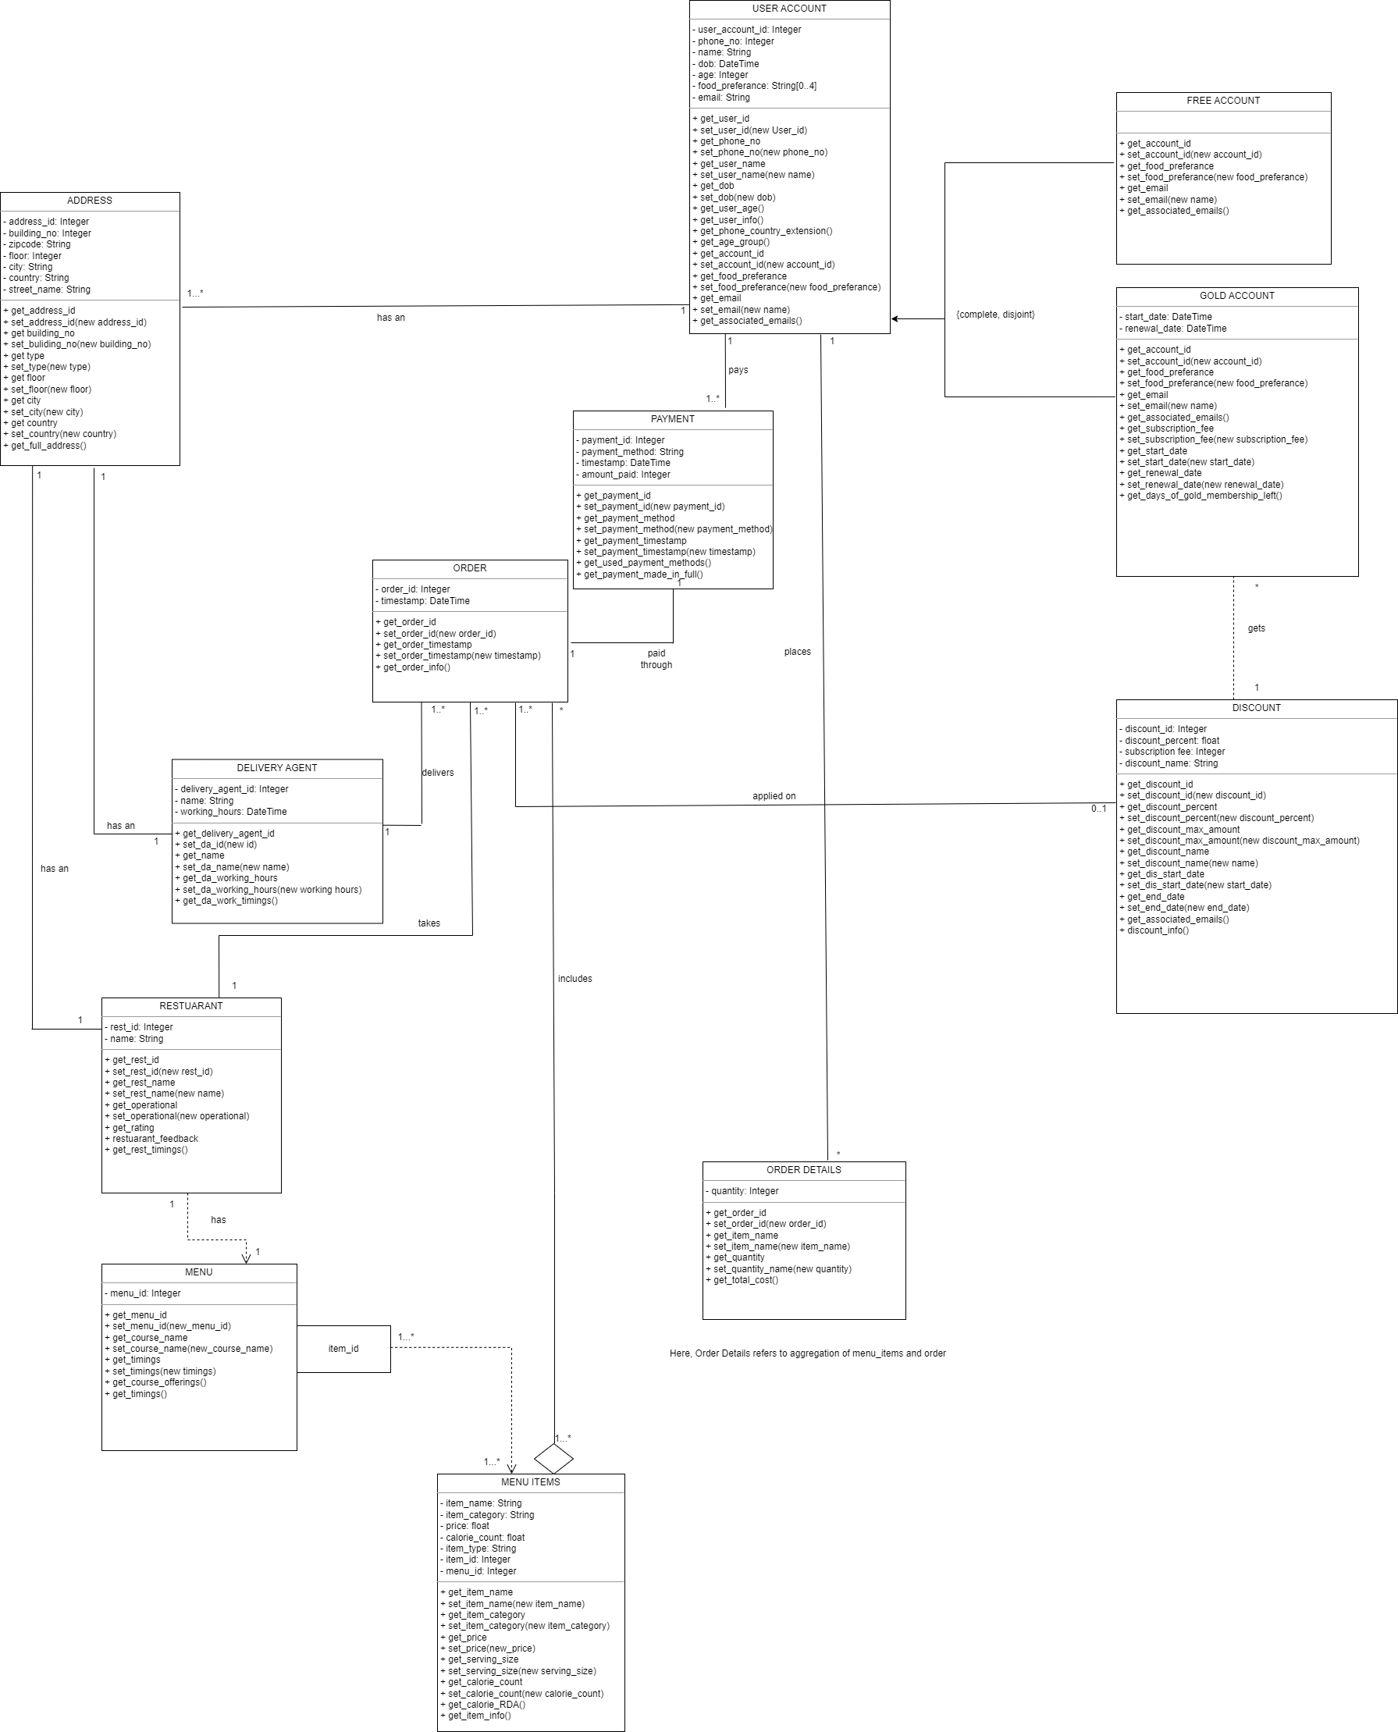
UML Diagram

Slide 5
Relational Models
Our relational model has a total of 14 tables/relations:
Address – holds address info
User_account – whole set of customers registered on the app
User_account_food_preference – the food preference of each customer
Free_account – free customers on the app
Gold_account – gold customers on the app
Discount – different gold subscriptions details
Payment – payment details of the ordered places
Order_details – order details
Orders – individual order identifier details
Menu – menu associated with a restaurant
Menu_item – items inside a particular menu
Menu_item_category – category each menu item belongs to
Restaurant – restaurants accepting orders on the app
Delivery_agent – delivery agent details

Slide 6
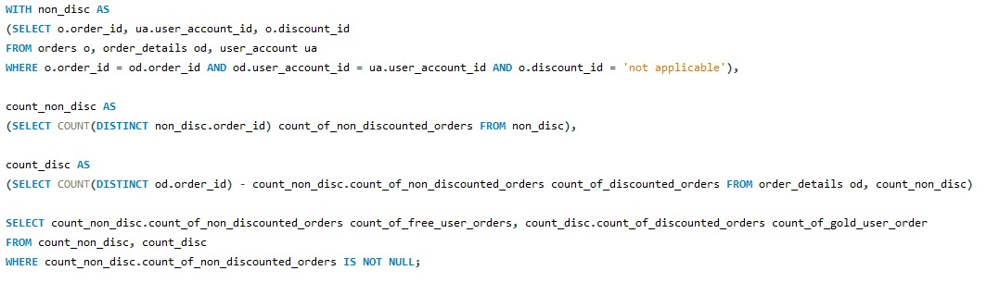
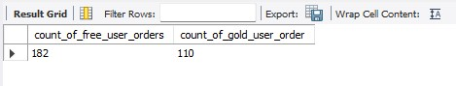
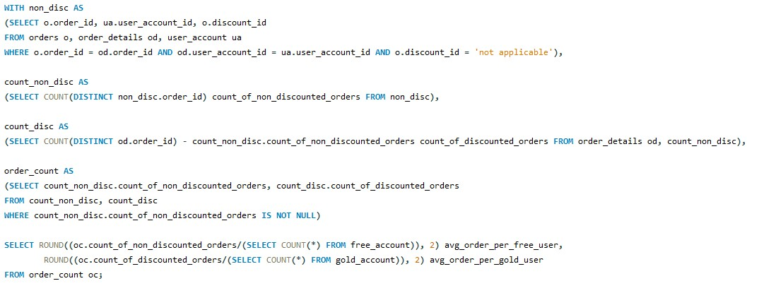
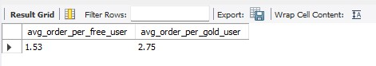
Analytical SQL Queries
1.First, let us look at the order count split between the free and the gold users:
From the output, it seems that the number of orders made by the free users are higher than the gold users. To better understand this split, we need to further investigate the number of orders made by each group of users and the average order per customer of the two groups.
2. Now, let us find the average no of orders per gold customer and free account customer:
The gold users order more often than the regular free user, this could be attributed to the fact that the gold user enjoys the discount associated with the gold account benefits.

Slide 7
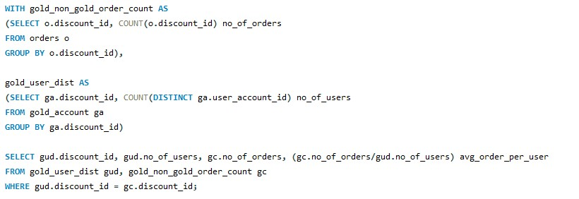
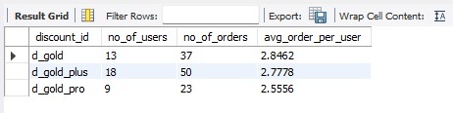
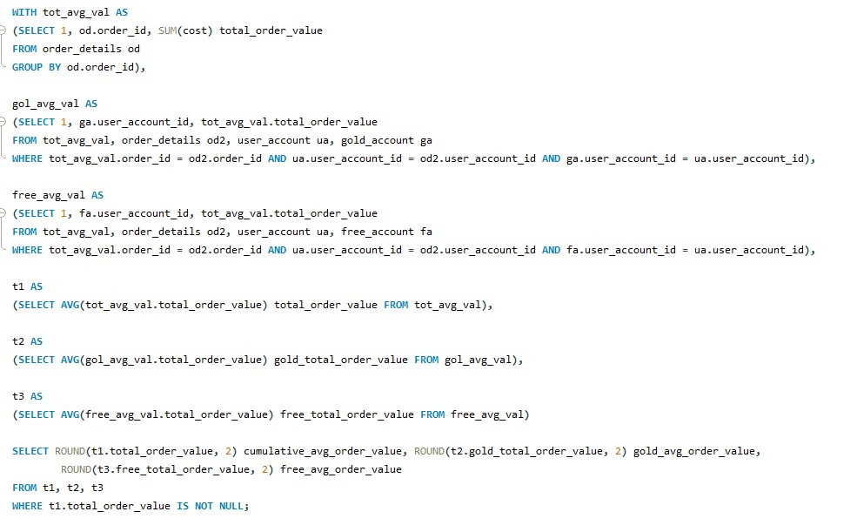
Analytical SQL Queries
3.Now, let us also see the most popular gold subscription, and the average order per respective gold subscription plan of that customer.
Looks like the gold plus subscription plan is the most popular, there are on average 100% and 40% more orders in comparison to the gold pro and gold orders, respectively. Also, in contrast to the subscribers for each gold package the average order per user is highest for gold users, followed by gold plus and then gold pro.
4.What is the average order value - overall, by non-gold and gold customers?

Slide 8
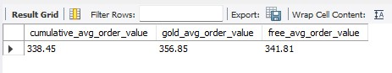
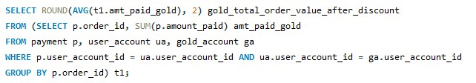
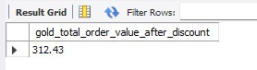
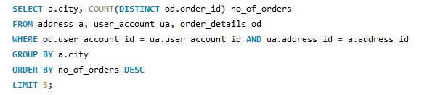
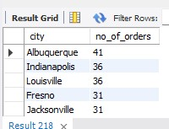
Analytic SQL Queries
We can see that the average order value of gold members is larger in comparison to the free account users. It would be interesting to see if the story remains even after we consider the gold discount offered to the gold members.
5.Now let's see average order value of the gold members after taking into account the discount offered on the orders.
The average order value is around 8% lesser than the total average order value for gold users, when we consider the discounts provided. In conclusion, the average order value is greater for gold users than free members, considering the additional subscription fee, it is beneficial for the company if a particular user moves from the free group to the gold group. Also, the gold plus is the most popular gold subscription, probably attributable to the anchoring effect of the gold plus subscription. We could optimize the pricing of the gold subscriptions even more, optimize the discount rates by looking into predicting future order/subscription patterns or even perform A/B testing for the optimal pricing of the subscription plan/discount rates. The above analysis completely focuses on the customer and their past behavior/pattern.
6.Now, let's explore the dataset based on geography, restaurant, menu item etc. Let's look at the most popular location, restaurant, and the menu items. First, the top 5 locations

Slide 9
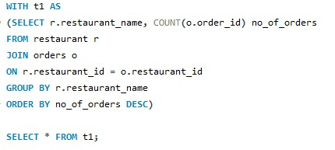
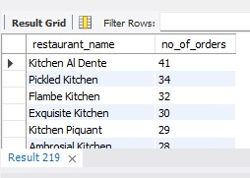
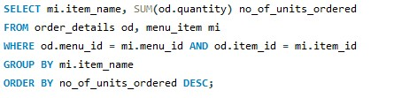
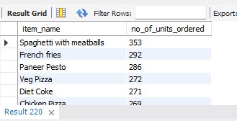
Analytic SQL Queries
Considering, the output of the above the top 5 cities are Albuquerque, Indianapolis, Louisville, Fresno, Jacksonville. We should move towards assigning a higher percentage of delivery agents in the above cities to optimize the delivery timings. Also, we could push more restaurants in the above areas to tie up with the FoodPro app, considering the high number of orders in the app in the above cities.
Next, the top 5 restaurants
From the above list we could approach the restaurants to make optimizations in cooking time to deliver the online orders through FoodPro. We could also consider starting a collaboration with the restaurant, to automatically sign up with FoodPro whenever they open a new branch; considering the popularity of the restaurant, the new branches are also expected to do well. This would further help in reducing the wait time of the delivery agents who would deliver the order from the above restaurants to the customer.
Now, let’s look at the most popular menu items
Spaghetti with meatballs, French fries, Paneer Pesto, Veg Pizza, Diet Coke are the top 5 items that ordered by the users; the restaurants can be guided to increase the inventory needed to fulfil the above orders. Also, interesting to note that 3 out of the top 5 most ordered items are fast food. Therefore, we can guide the restaurant to revamp the menu items to include more fast food, as they are the most selling and they ideally have higher margins and shorter cooking time
7.Now, let’s see the most popular food_preference that was ordered.

Slide 10
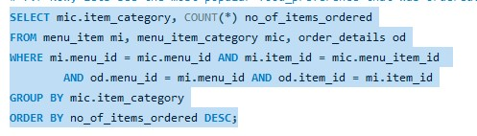
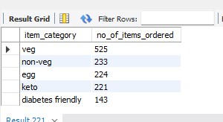
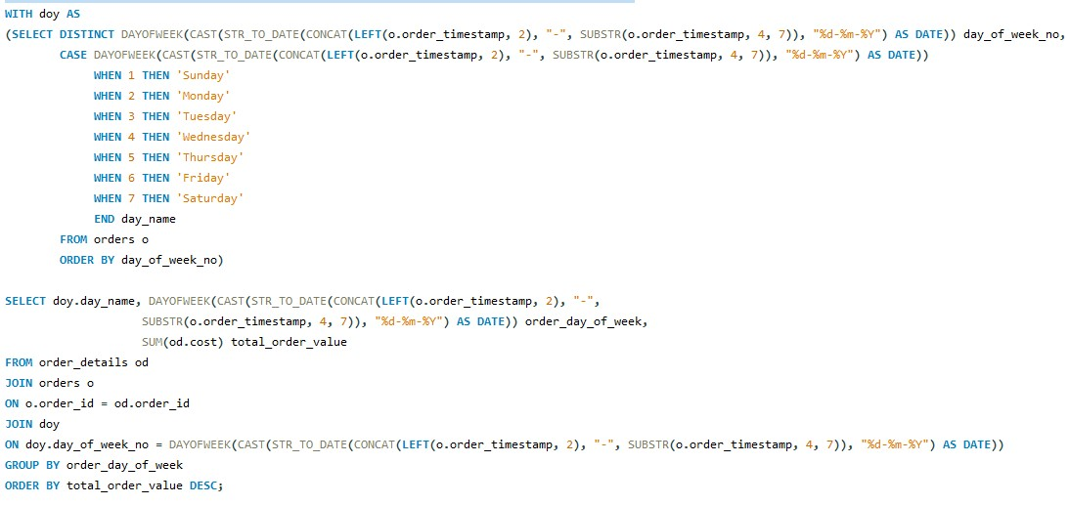
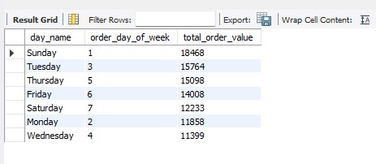
Analytic SQL Queries
Looks like the people preferred to order veg items by more than 100% than the second most ordered food category - non-veg. This could guide the restaurants in looking into adding more vegetarian options on their menu. It is also interesting to note that keto being a category which would be ordered by a niche group of people, sits high up along with non-veg and egg items. This could be an opportunity to come up with more specific diet focused meal plans (vegan/keto/lean) - because these orders are usually ordered by the same group of people in a periodic manner - this would help us in streamlining the delivery process as well, as we would be prepared with a clear schedule about the delivery.
8.Now, let’s check the revenue generated (by orders) split based on the day of the week
First, we generate a CTE table to clean the order date column and get the day of the order

Slide 11
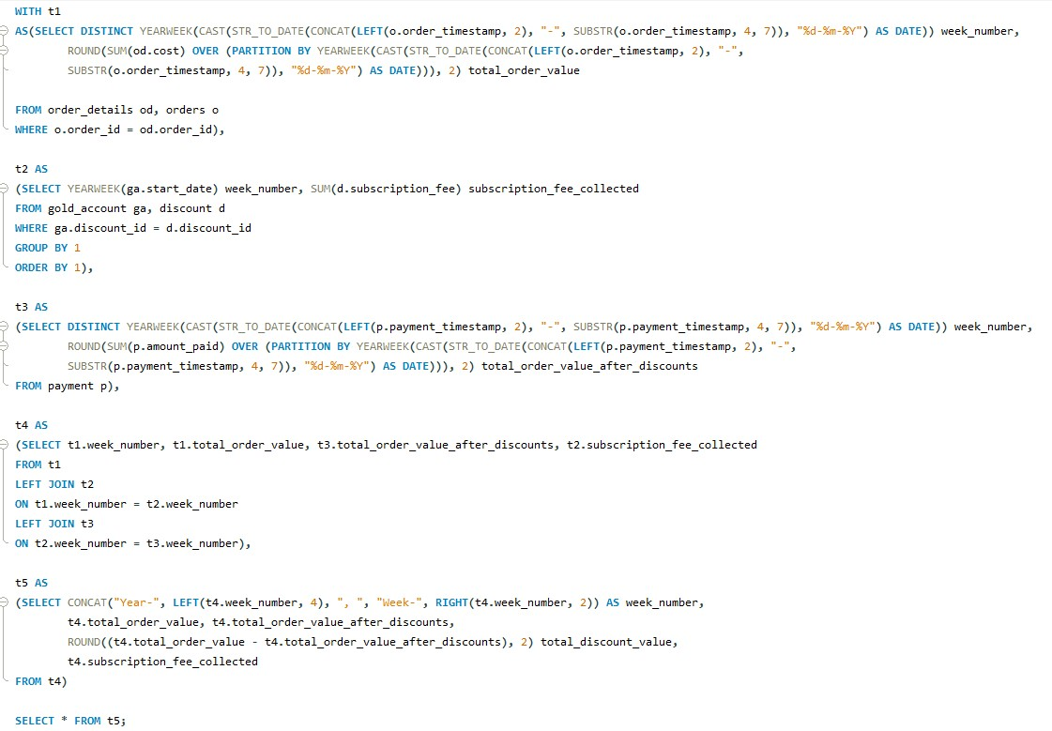
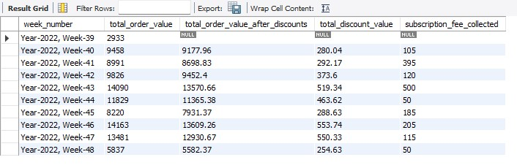
Analytic SQL Queries
9.Now, let’s create a mini week-wise balance sheet and look at the revenue numbers

Slide 12
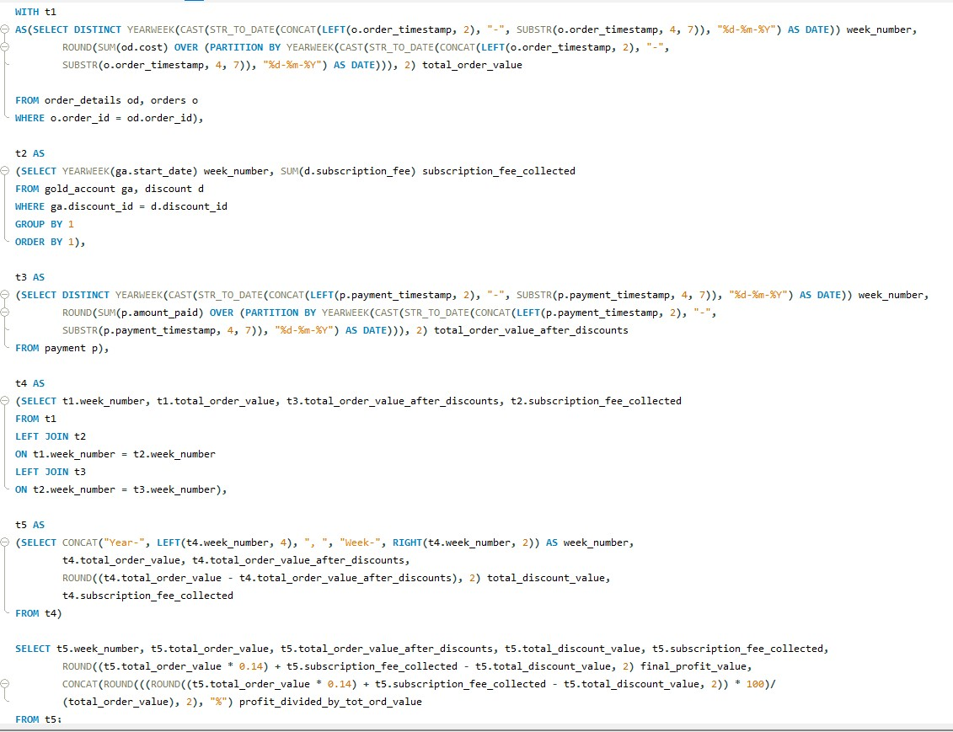
Analytic SQL Queries
The order value is the highest for the combined consecutive week 46/47, this could be attributed to the thanksgiving week festivities. With people travelling from different places, and staying home, more orders can be expected around the holidays. We can further think about providing some extra discount during the holiday season to boost sales of both the orders as well as the subscriptions plans.
Let's calculate the profit made on a weekly basis considering a flat profit margin of 14% (after deducting the operational cost, rest payments etc on the order value.

Slide 13
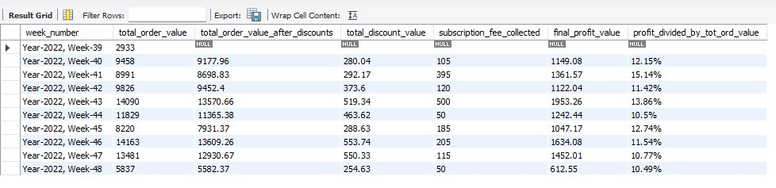
Analytic SQL Queries
Now, looking at the final profit values at a profit margin of 14%, we can clearly see that the final_profit per week is the highest for week 43, and a look at the profit percentages as a proportion of the
total_order_value, we ca see that the profit % is highest for week 41, which can be attributed to the high number of gold subscriptions and the lesser discounts because fewer people were using the gold subscription discounts.

Slide 14
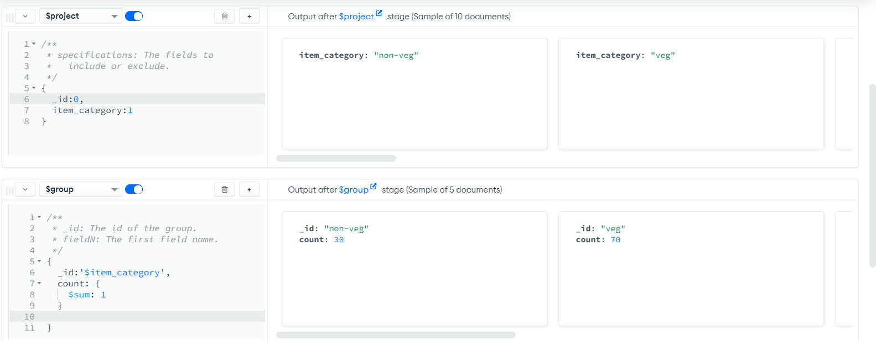
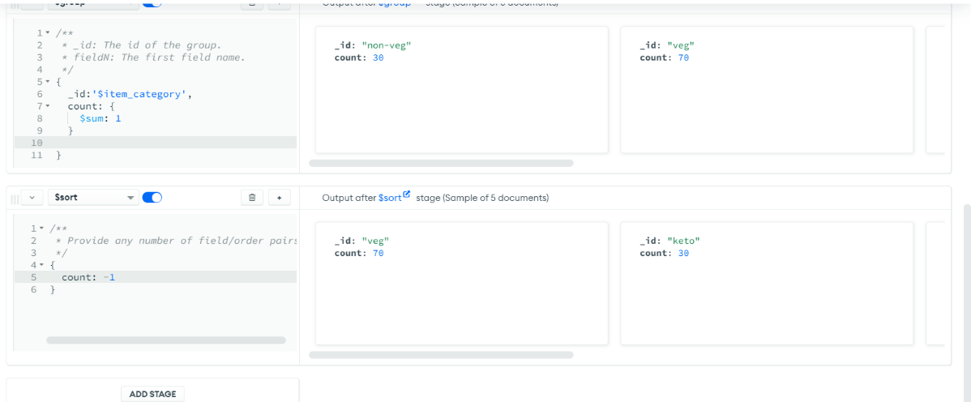
Analytic NoSQL Queries
From the above query, we get the most frequently ordered food item category, thus helping the restaurants about inventory stocking based on popularity of the food items, for example preparing for veg dishes early by making certain sauces and chopping certain vegetables, would ensure to quick TAT.

Slide 15
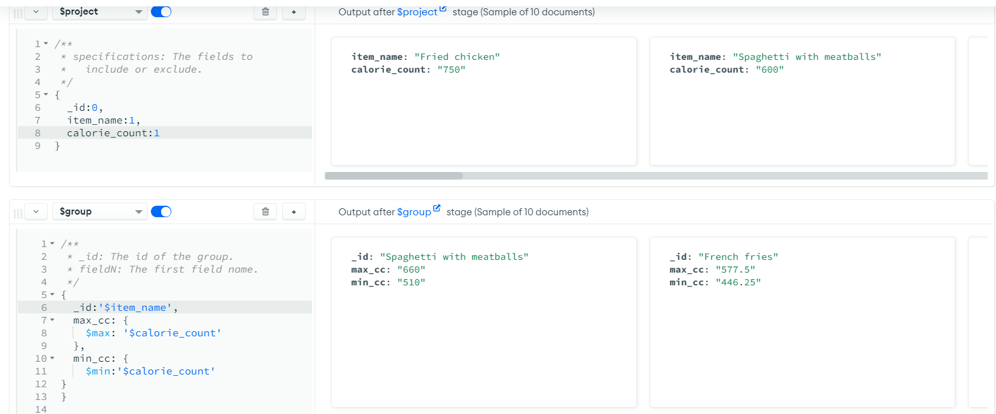
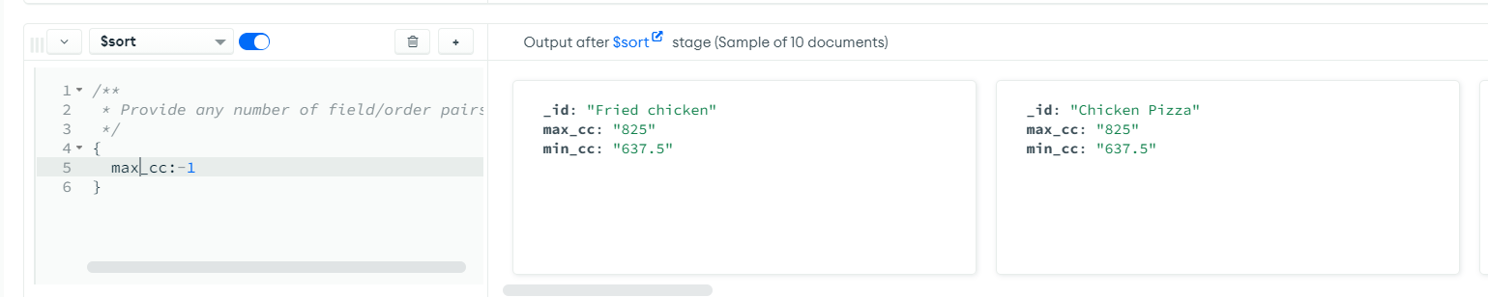
Analytic NoSQL Queries
Here we are getting the dish having the highest value of calories

Slide 16
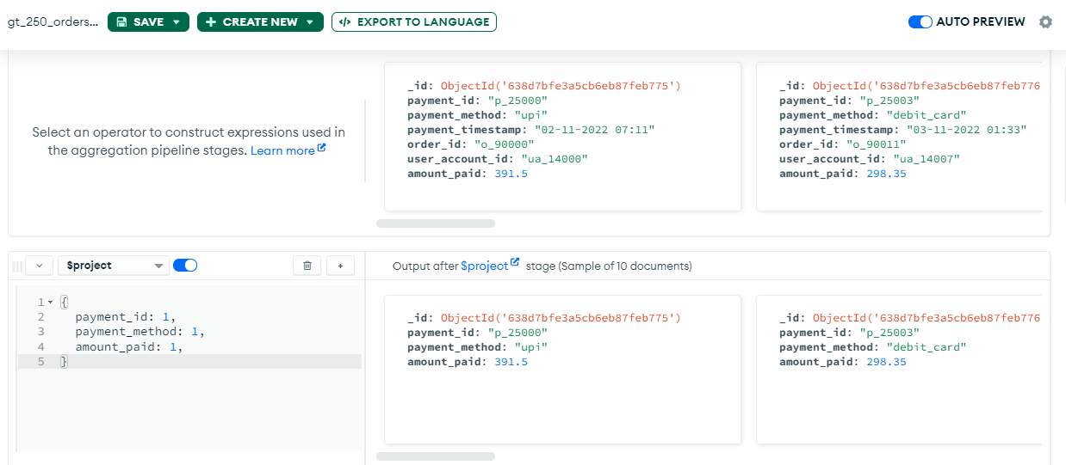
Analytic NoSQL Queries – Aggregate Pipeline
Here we are creating a simple Aggregation pipeline; It calculates the count of the payment methods used, and the aggregate value of the amount paid, for order values of over 250.
The first stage is the project stage where we select out the required keys/tuples

Slide 17
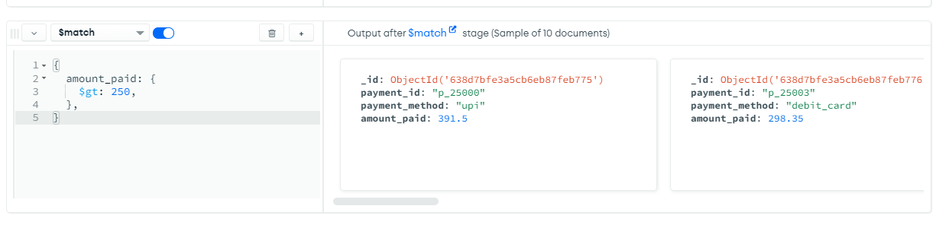
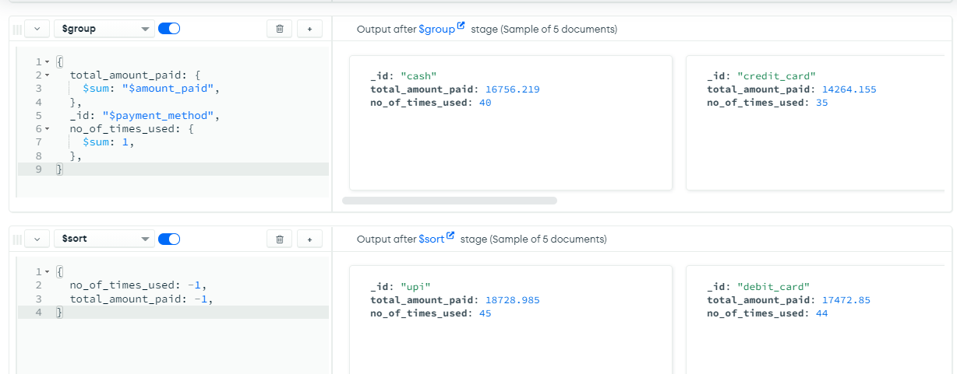
Analytic NoSQL Queries
The next stage is the match, where we filter out the order values greater than 250
The final two stages and the group and the sort where we group the key value pairs by the payment method to calculate the total amount and number of times each payment method is used. The sort stage sorts the output key value pair in descending order by the no of times a particular payment method was used and then the total amount paid using that particular payment method.

Slide 18
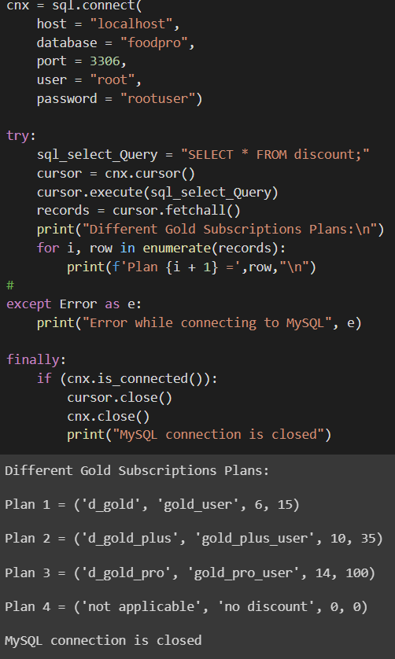
Python Visualizations

Slide 19
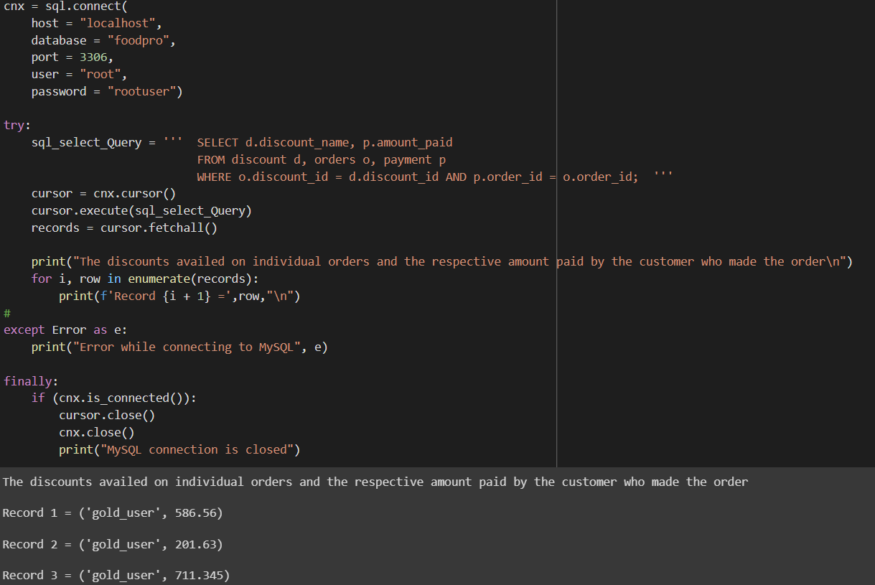
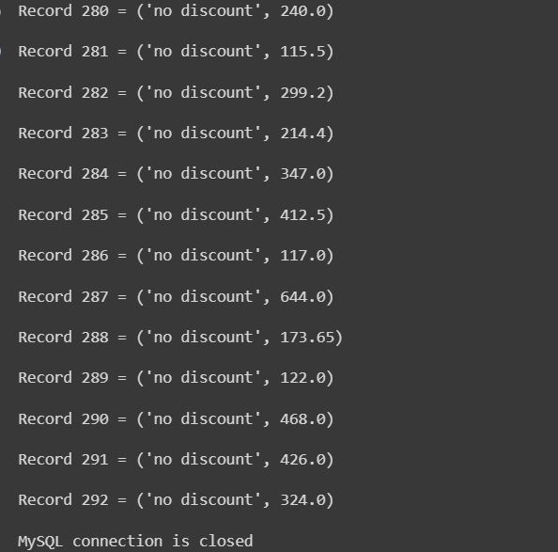
Python Visualizations

Slide 20
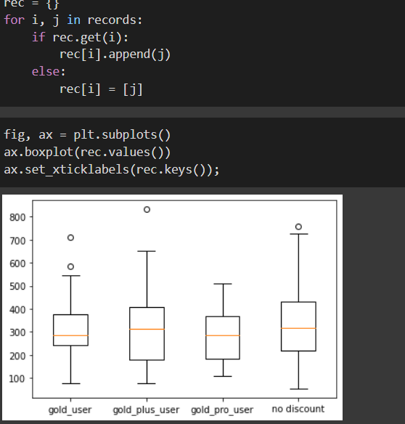
Python Visualizations
The gold subscription plan users show lesser variations in their order ranges.

Slide 21
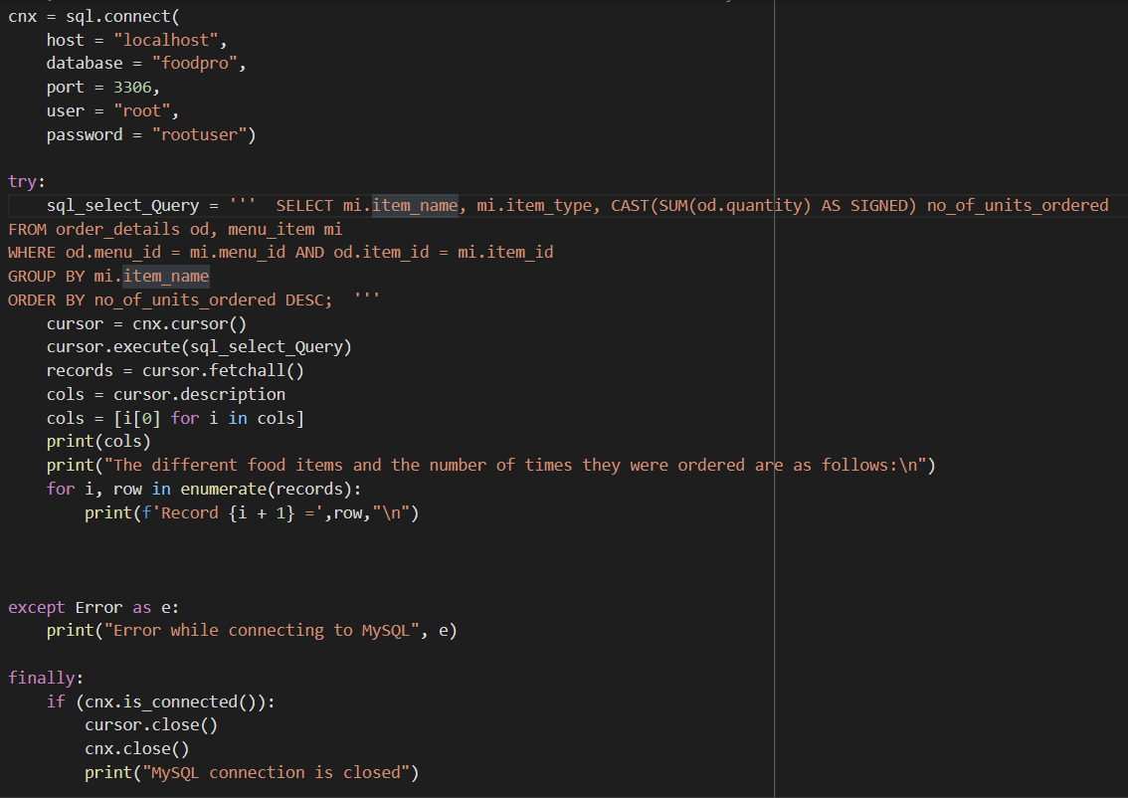
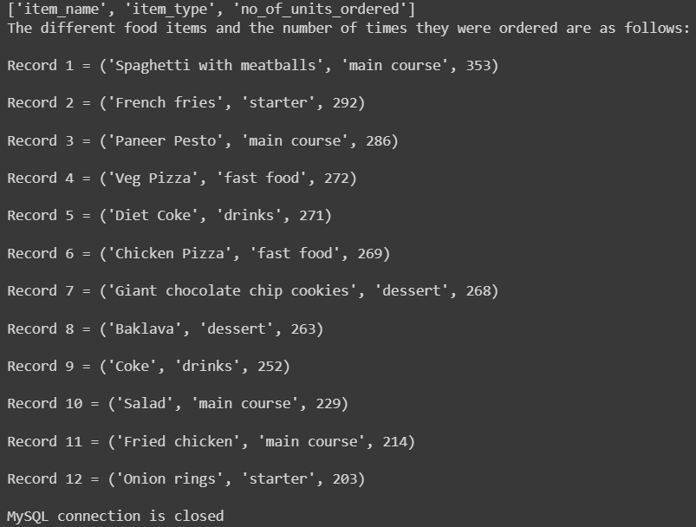
Python Visualizations
→Now, lets look at the different dishes offered and the number of times they were ordered

Slide 22
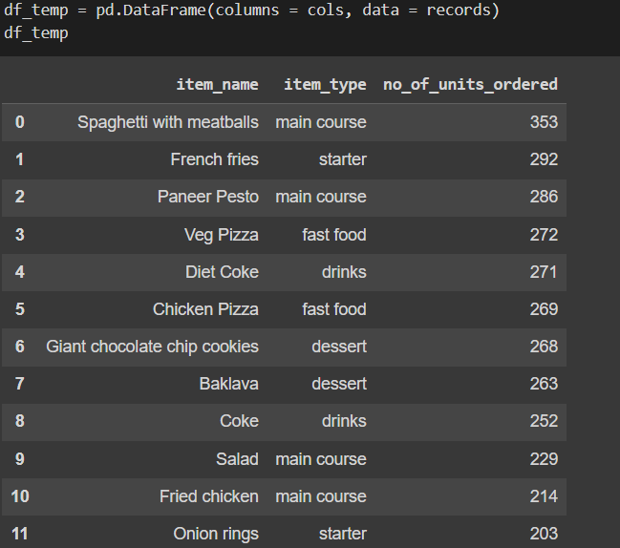
Python Visualizations

Slide 23
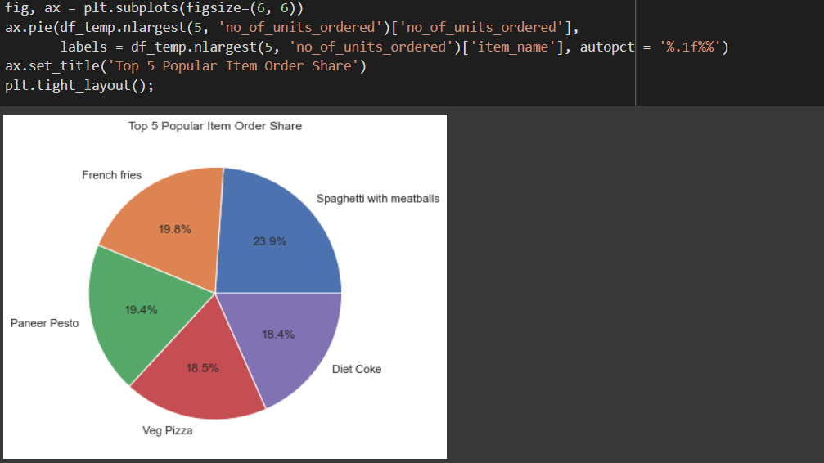
Python Visualizations
Spaghetti with meatballs, French fries, Paneer Pesto, Veg Pizza, Diet Coke are the top 5 items that ordered by the users; the restaurants can be guided to increase the inventory needed to fulfill the above orders. Also, interesting to note that 3 out of the top 5 most ordered items are fast food. Therefore, we can guide the restaurant to revamp the menu items to include more fast food, as they are the most selling and they ideally have higher margins and shorter cooking time.

Slide 24
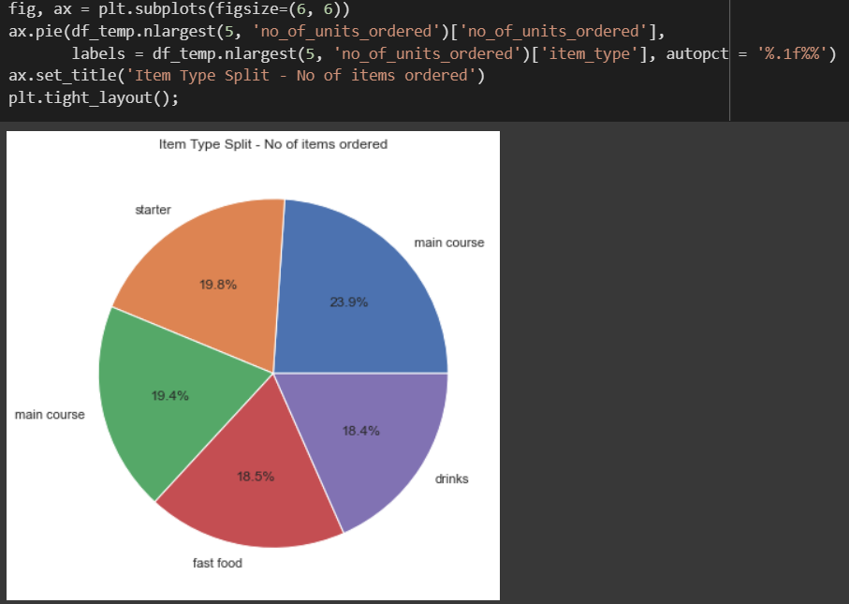
Python Visualizations

Slide 25
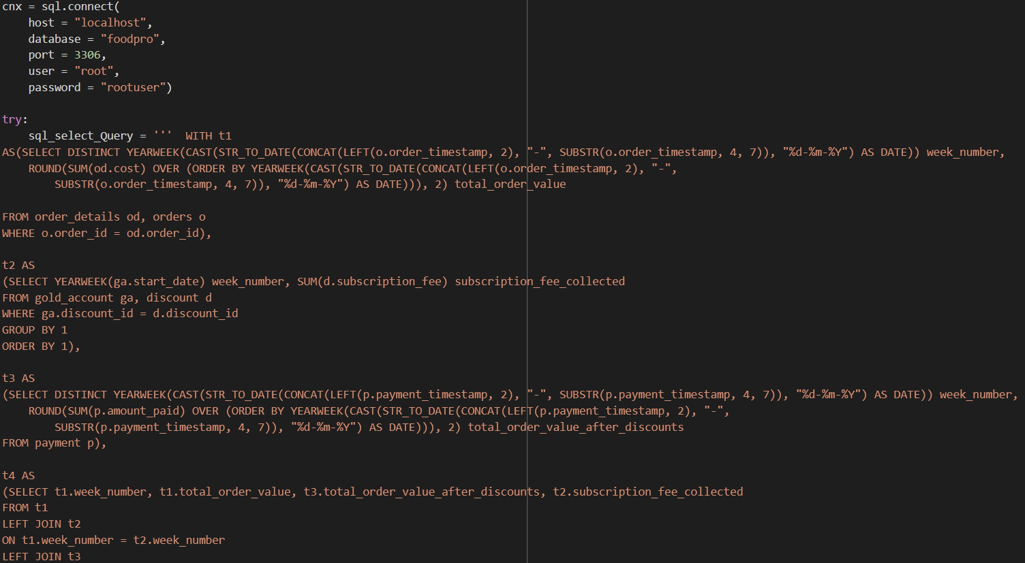
Python Visualizations

Slide 26
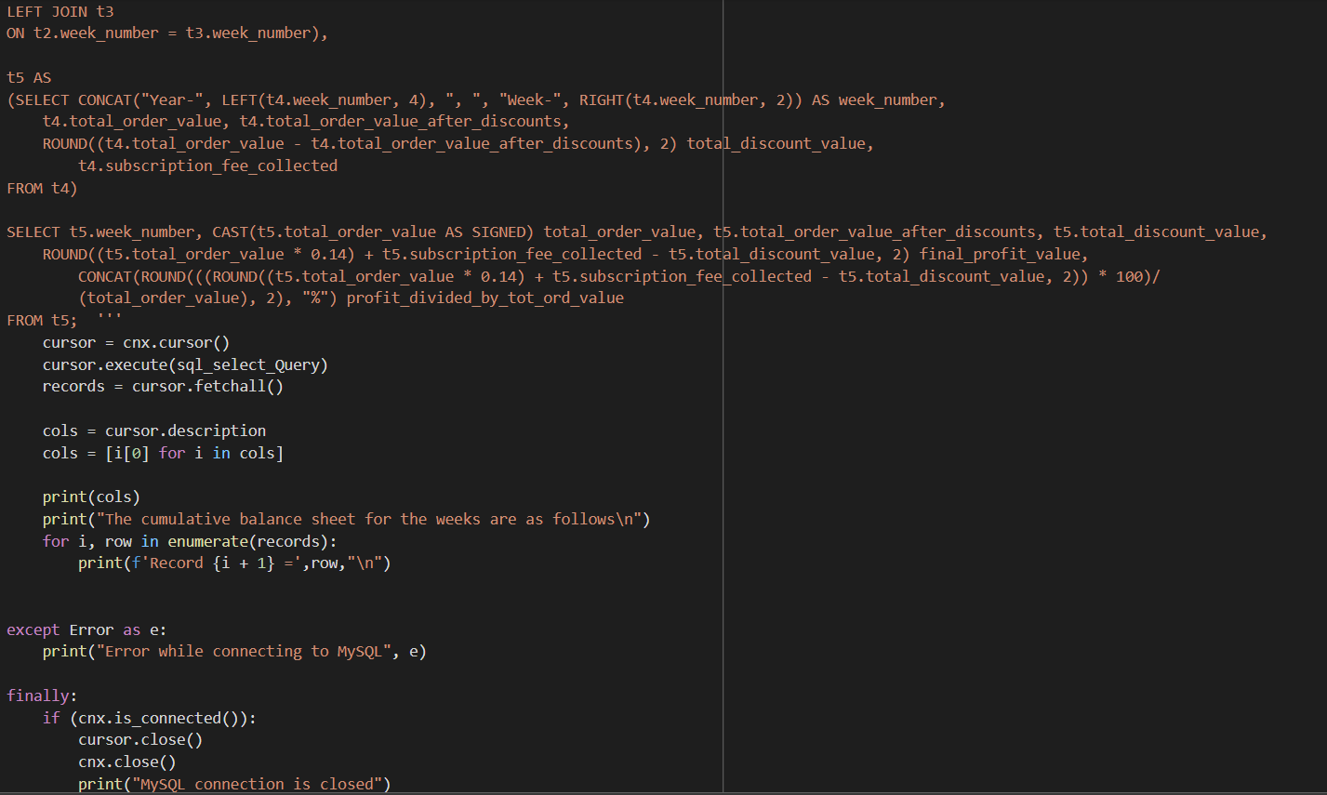
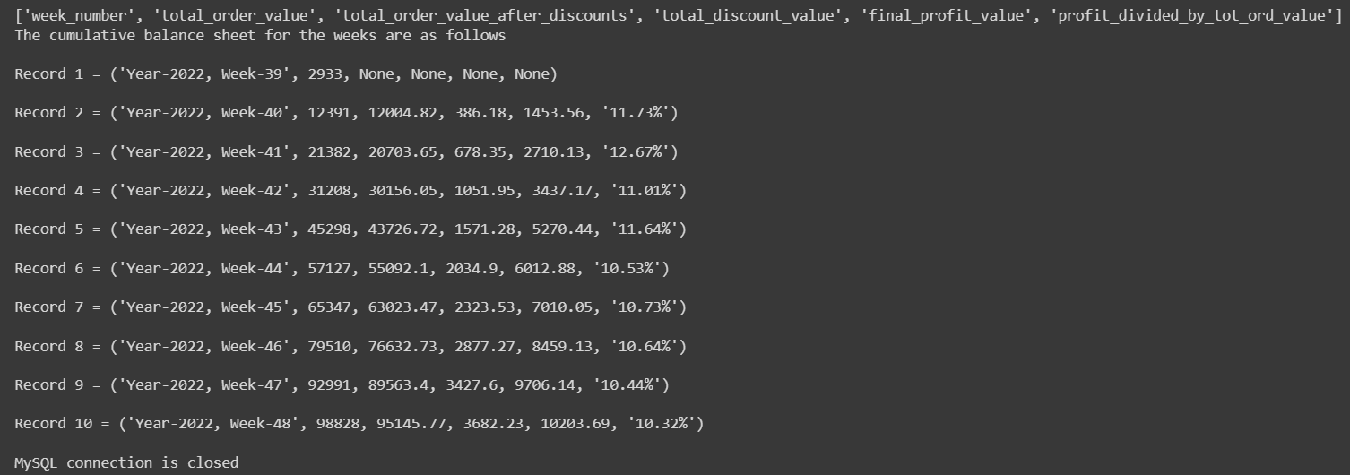
Python Visualizations

Slide 27
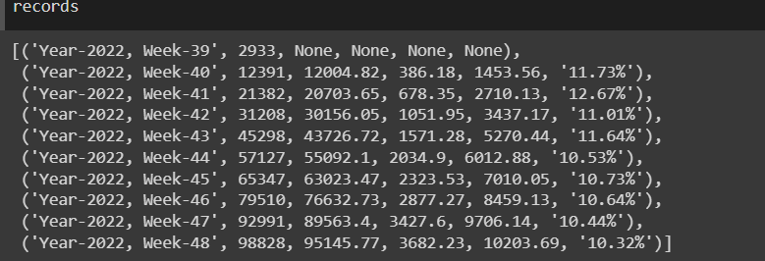
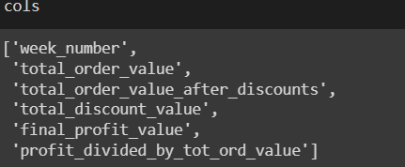
Python Visualizations
The individual record values are as follows:
The columns are as follows:

Slide 28
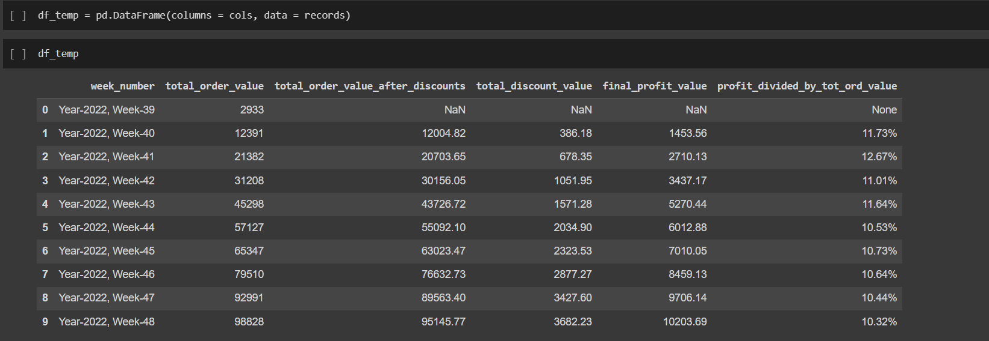
Python Visualizations
Let's visualize the mini balance sheet in a data frame - Note that the values given are cumulative in nature and not the individual week values

Slide 29
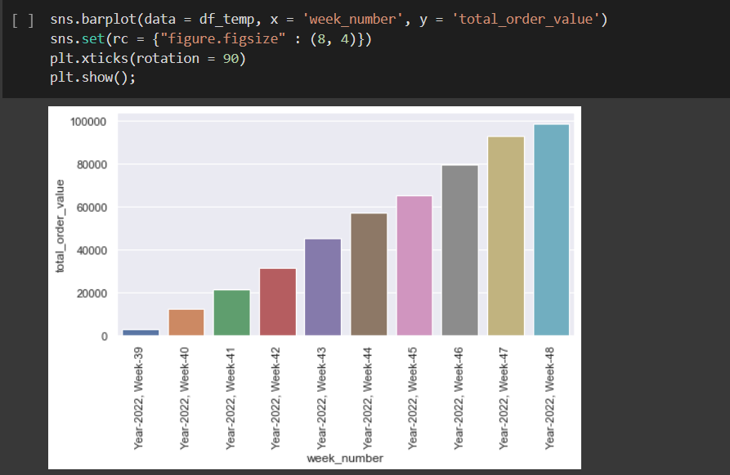
Python Visualizations
The sales week over week have been consistently increasing which is a good sign. Considering the higher discounts (in terms of volume) offered to customers, it would be interesting to see if the graph pattern remains the same when looking into the final profit. Also, the order value is the highest for the combined consecutive week 46/47, this could be attributed to the thanksgiving week festivities. With people travelling from different places, and staying home, more orders can be expected around the holidays. We can further think about providing some extra discount during the holiday season to boost sales of both the orders as well as the subscriptions plans.

Slide 30
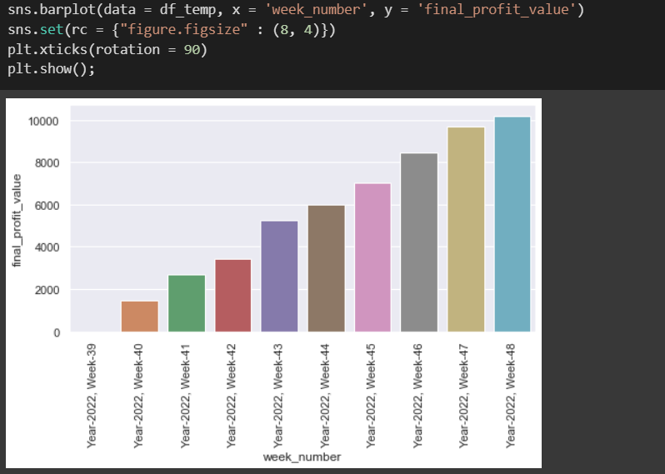
Python Visualizations
It seems like the profit values increased consistently in the first 8 weeks and then the increase rate reduced. So, the final profit % considering a flat profit margin of 14% (on order value) is hovering around 10-11%. Also, looking at the final profit values at a profit margin of 14%, we can clearly see that the final_profit per week is the highest for week 43, and a look at the profit percentages as a proportion of the total_order_value, we ca see that the profit % is highest for week 41, which can be attributed to the high number of gold subscriptions and the lesser discounts because fewer people were using the gold subscription discounts.

Slide 31


Python Visualizations
Now we will try to visualize the average number of orders between gold and non gold customers:

Slide 32


Python Visualizations
The gold users order more often than the regular free user, this could be attributed to the fact that the gold user enjoys the discount associated with the gold account benefits.

Slide 33


Python Visualizations
Now let's look at the average order value of gold and non gold customers
now, well try to visualize the change in revenue/profit by looking at the income growth/decline in a waterfall graph

Slide 34

Python Visualizations
We can see that the average order value of gold members is larger in comparison to the free account users. It would be interesting to see if the story remains even after we consider the gold discount offered to the gold members

Slide 35



Python Visualizations
Now, well try to visualize the change in revenue/profit by looking at the income growth/decline in a waterfall graph

Slide 36

Python Visualizations

Slide 37


Python Visualizations
The order value (with and without discount) and the discounts given show constant increase with the rate reducing in the latest weeks. The subscription fee collected has also reduced in comparison to the earlier days of the app. So, we can focus on revamping the subscription plan structure; think of new ways of incentivizing buying a subscription plan, because it has clearly been established that gold users use the app to buy larger orders than non gold users.

